Slide 1
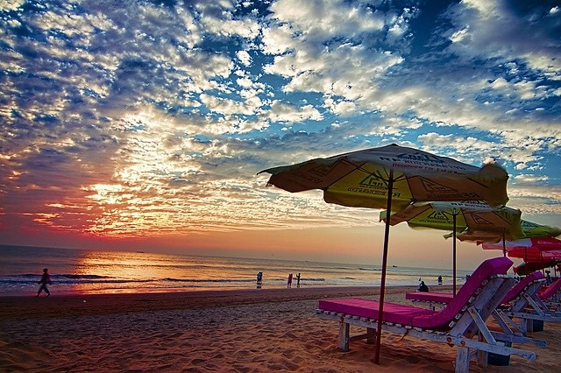
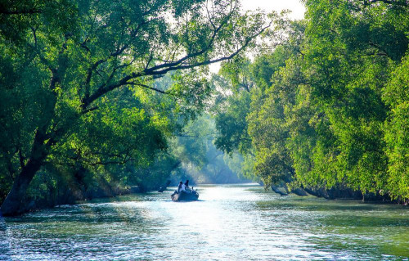
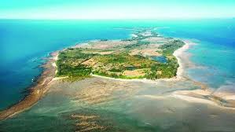
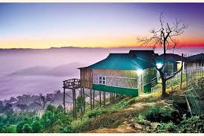
Bangladesh

Slide 2
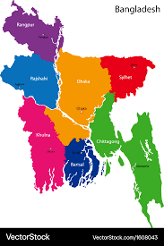
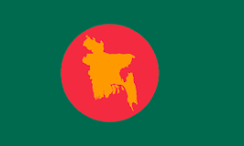
Independence
The Bangladesh Liberation War started on 26 March and lasted till 16 December 1971 which is celebrated as Victory Day in Bangladesh. In the early hours of March 26, 1971, the undisputed leader of Bengali, Sheikh Mujibur Rahman, declared independence before being arrested by the Pakistani army.

Slide 3
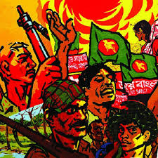
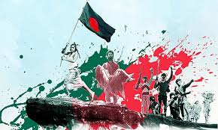
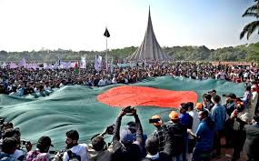
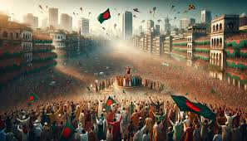
Liberation War
the war began after the Pakistani military junta based in West Pakistan launched Operation Searchlight against the people of East Pakistan on the night of 25 March 1971. It pursued the systematic elimination of nationalist Bengali civilians, students, intelligentsia, religious minorities and armed personnel.

Slide 4
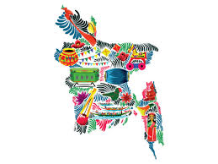

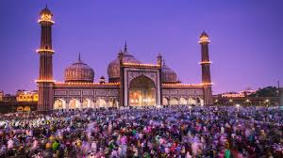
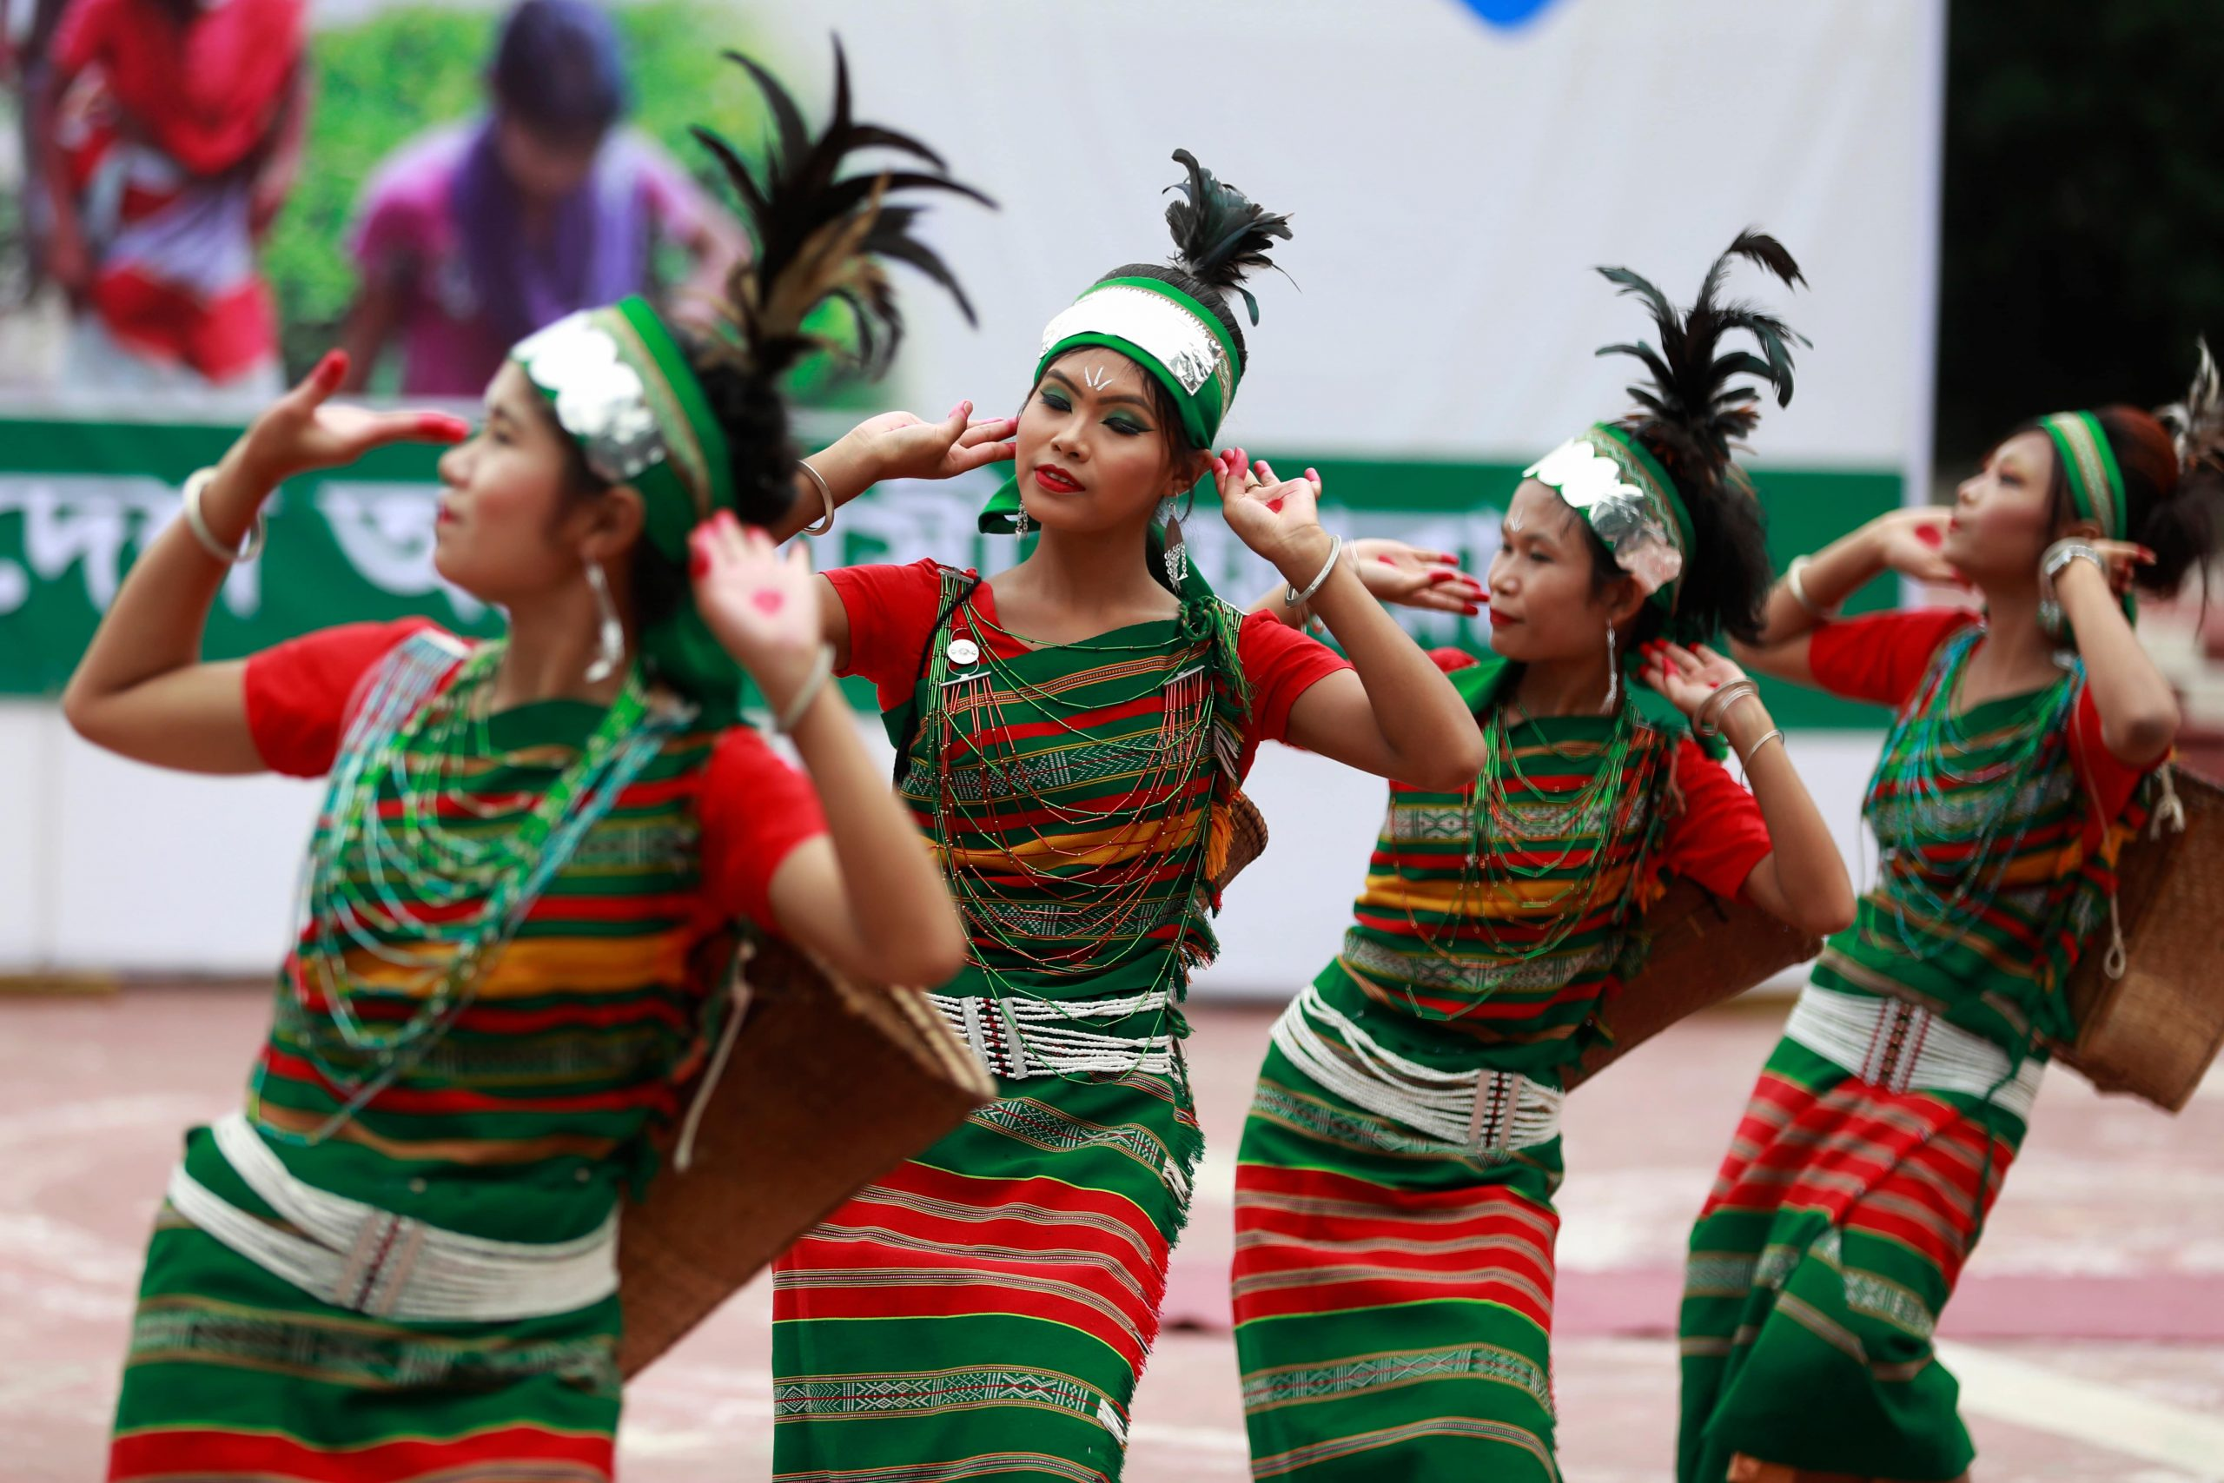
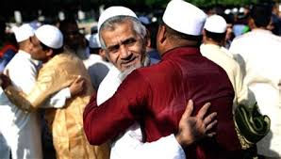
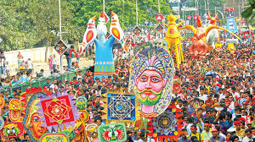
Cultuer of BD
The Bengal region has a multifaceted folk heritage, enriched by its ancient animist, Buddhist, Hindu, and Muslim roots. Weaving, pottery and terracotta sculpture are some of the earliest forms of artistic expression.

Slide 5
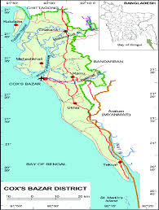
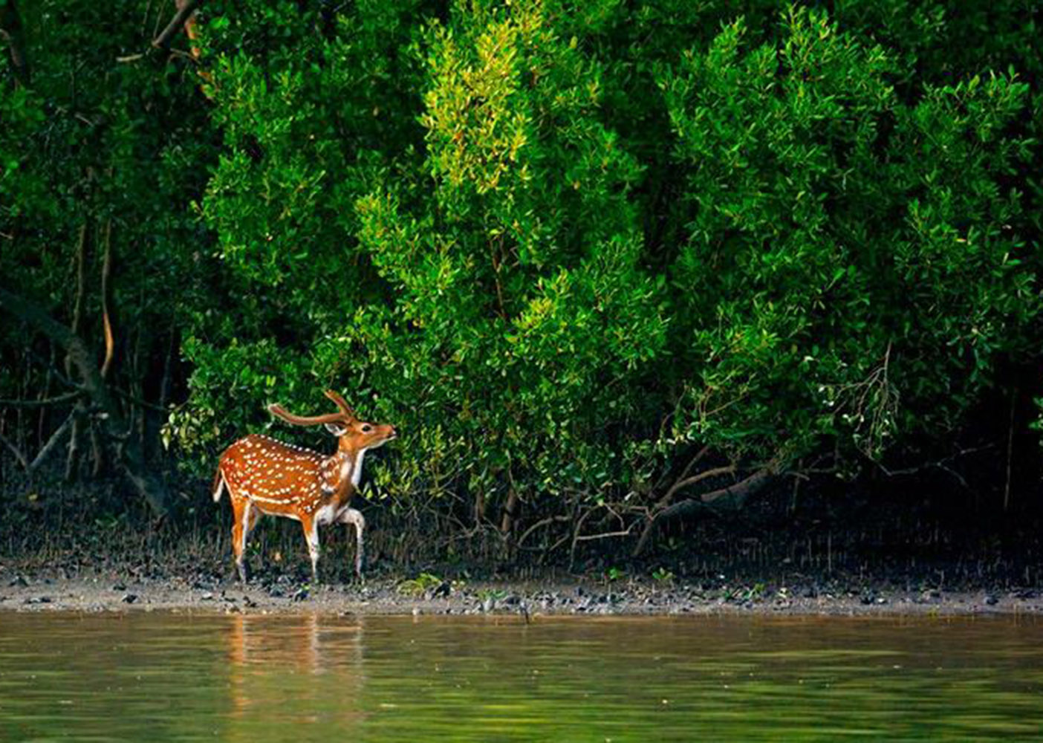
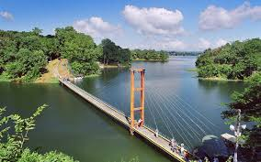
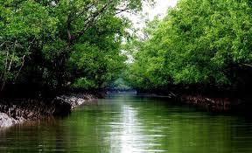
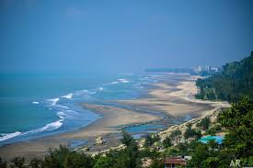
Beauty
Sea beach
Cox”s Bazar
Inani beach
Rangamati
Bandarban
Forest
sundarban
Chittagong
Khagrachari
Bangladesh has a land of enormous natural beauty, hundreds of rivers, crystal clear water, lakes surrounded by green hills, tropical rain forests, world's largest mangrove forest, home of the Royal Bengal Tiger and the wild lives

Slide 6
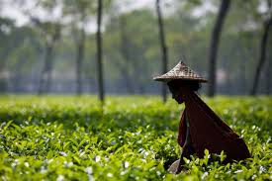
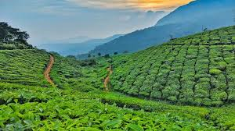
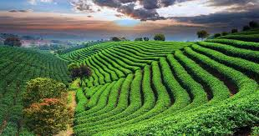
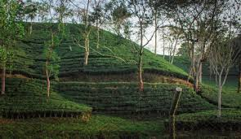
Tea Forest
Lakkatura tea garden
Sreemongol rain forest
Malnicherra tea garden

Slide 7
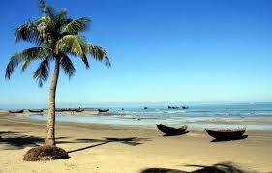
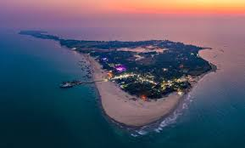
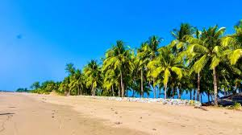
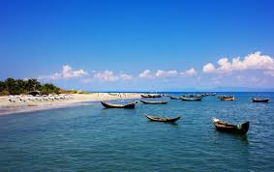
Saint martin

Slide 8
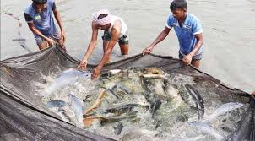
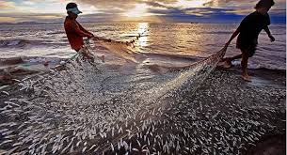
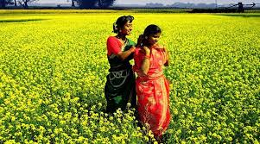
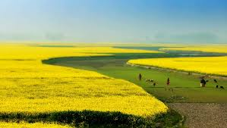
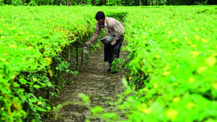
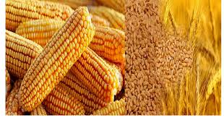
Agriculture

Slide 9
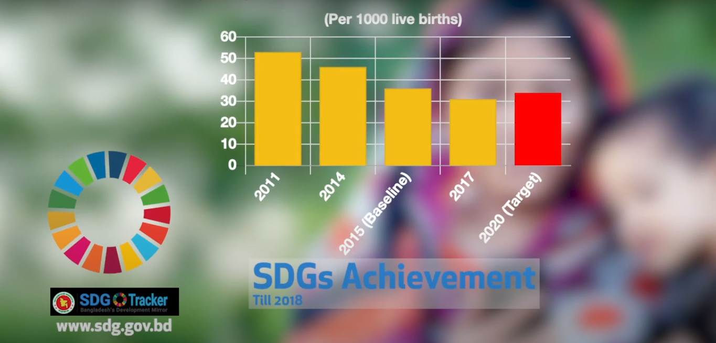
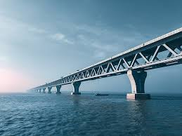
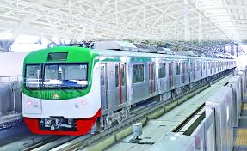
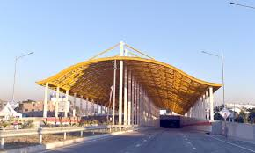
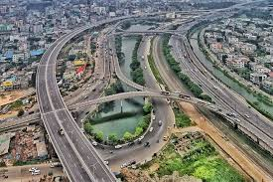
Development
In the 40 years since its birth from ashes and fire, Bangladesh has registered many gains. In terms of Millennium Development Goals, Bangladesh has achieved remarkable progress in the areas of primary schooling, lowering the infant and under-five mortality rate and overall poverty reduction.

Slide 10
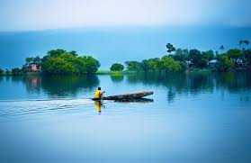
THANK YOU

